Slide 1
PROGRAMMING IN PYTHON
Control Structures
Mrs. C.SHYAMALADEVI M.C.A., M.Phil., B.Ed.,
ASSISTANT PROFESSOR,
DEPARTMENT OF COMPUTER SCIENCE,
SHRIMATI INDIRA GANDHI COLLEGE,
TRICHY-2.

Slide 2
• To gain knowledge on the various flow of control in Python language.
• To learn through the syntax how to use conditional construct to improve the efficiency of the program flow.
• To apply iteration structures to develop code to repeat the program segment for specific number of times or till the condition is satisfied.

Slide 3


Slide 4
Programs may contain set of statements.
These statements are the executable segments that yield the result.
In general, statements are executed sequentially, that is the statements are executed one after another.

Slide 5
There may be situations in our real life programming where we need to skip a segment or set of statements and execute another segment based on the test of a condition.
This is called alternative or branching.

Slide 6
Also, we may need to execute a set of statements multiple times, called iteration or looping.
In this chapter we are to focus on the various control structures in Python, their syntax and learn how to develop the programs using them.

Slide 7
Control Structures

Slide 8
A program statement that causes a jump of control from one part of the program to another is called control structure or control statement.

Slide 9
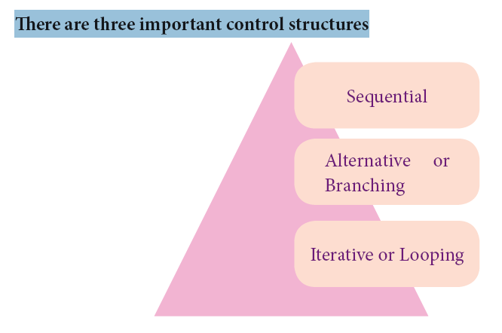

Slide 10
Sequential Statement

Slide 11
A sequential statement is composed of a sequence of statements which are executed one after another.

Slide 12
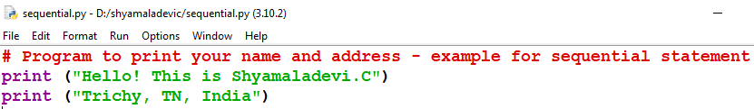
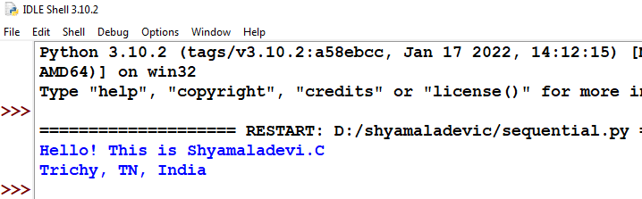
Example

Slide 13
Alternative
or
Branching Statement

Slide 14
• Simple if statement
• if..else statement
• if..elif statement

Slide 15
Simple if statement

Slide 16
Simple if is the simplest of all decision making statements. Condition should be in the form of relational or logical expression.

Slide 17
Syntax
if <condition>:
statements-block1

Slide 18
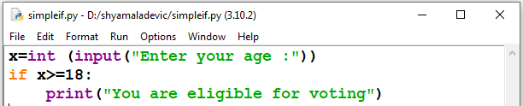
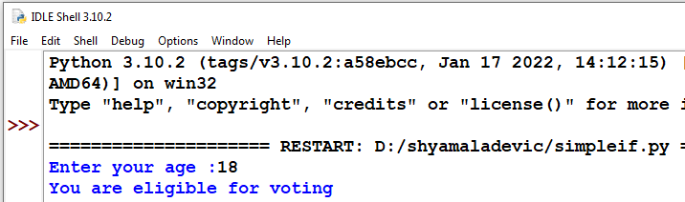
Example - Program to check the age and print whether eligible for voting

Slide 19
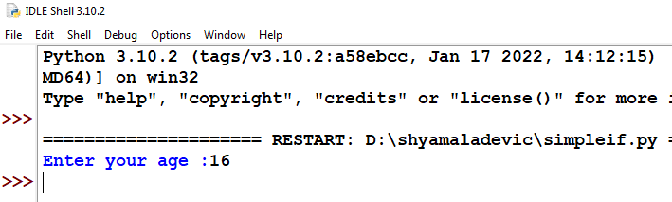
x=int (input("Enter your age :"))
if x>=18:
print("You are eligible for voting")

Slide 20
if..else statement

Slide 21
Syntax
if <condition>:
statements-block1
else:
statements-block2

Slide 22
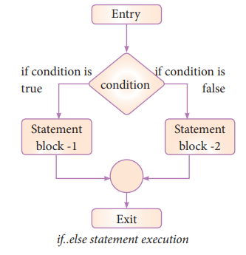

Slide 23
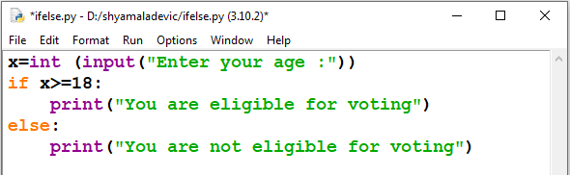
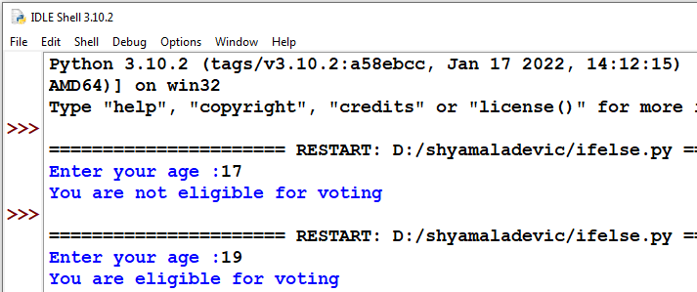
Example - Program to check if the accepted number odd or even

Slide 24
x=int (input("Enter your age :"))
if x>=18:
print("You are eligible for voting")
else:
print("You are not eligible for voting")

Slide 25
An alternate method to rewrite the above program is also available in Python.
The complete if..else can also written as:

Slide 26
Syntax
variable = variable1 if condition else variable 2

Slide 27
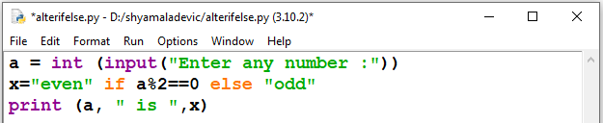
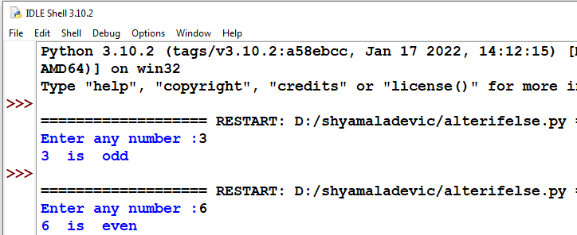
Example - Program to check if the accepted number is odd or even (using alternate method of if...else)

Slide 28
a = int (input("Enter any number :"))
x="even" if a%2==0 else "odd"
print (a, " is ",x)

Slide 29
Nested if..elif...else statement

Slide 30
Syntax
if <condition-1>:
statements-block 1
elif <condition-2>:
statements-block 2
else:
statements-block n

Slide 31
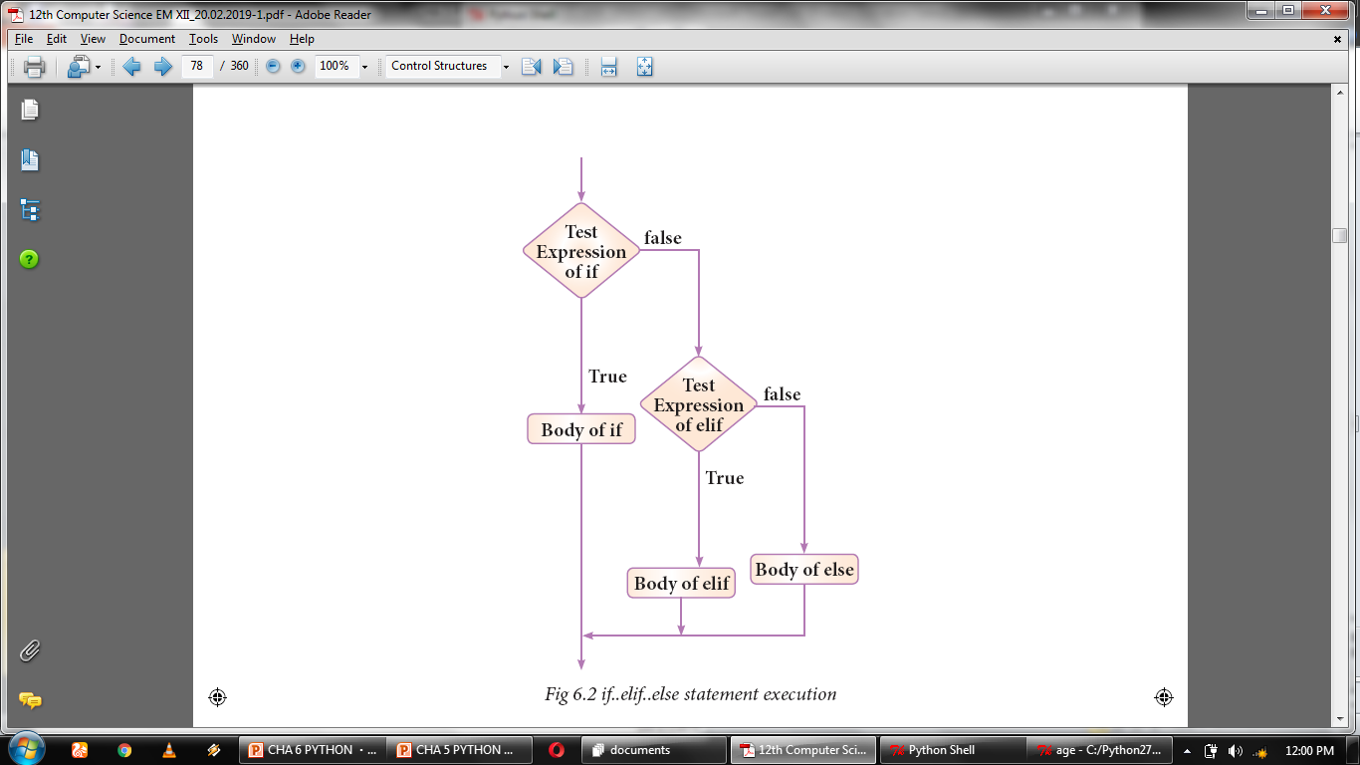

Slide 32
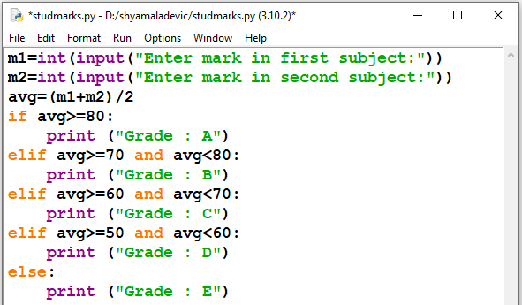
Example - Program to illustrate the use of nested if statement

Slide 33
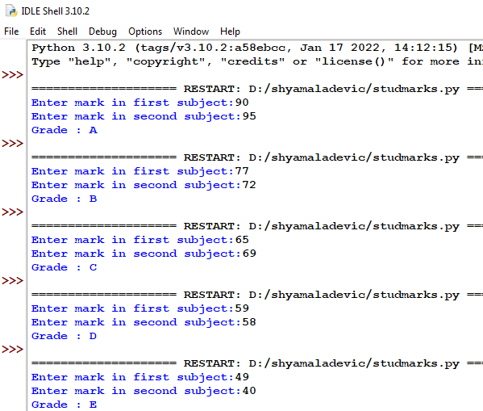

Slide 34
m1=int(input("Enter mark in first subject:"))
m2=int(input("Enter mark in second subject:"))
avg=(m1+m2)/2
if avg>=80:
print ("Grade : A")
elif avg>=70 and avg<80:
print ("Grade : B")
elif avg>=60 and avg<70:
print ("Grade : C")
elif avg>=50 and avg<60:
print ("Grade : D")
else:
print ("Grade : E")

Slide 35
Iteration or Looping constructs

Slide 36
A loop statement allows to execute a statement or group of statements multiple times.

Slide 37
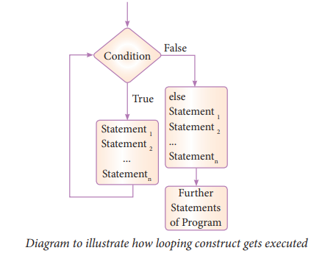

Slide 38
Python provides two types of looping constructs:
• while loop
• for loop

Slide 39
while loop

Slide 40
Syntax
while <condition>:
statements block 1
[else:
statements block2]

Slide 41
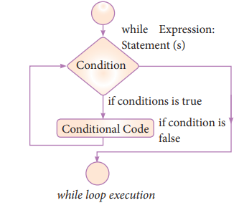

Slide 42
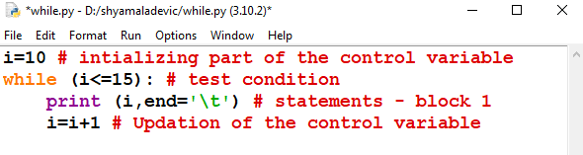
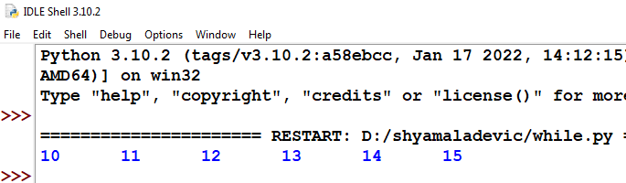
Example - Program to illustrate the use of while loop - to print all numbers from 10 to 15

Slide 43
i = 10
while i < =15:
print(i)
i += 1

Slide 44
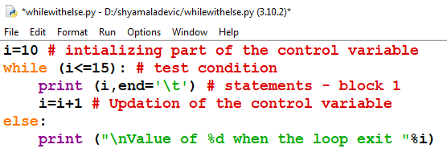
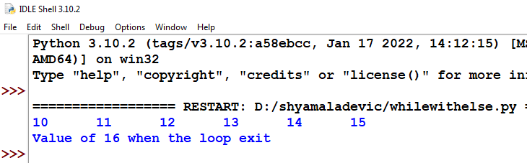
Example - Program to illustrate the use of while loop - with else part

Slide 45
for loop

Slide 46
x = 10
while (x < 16):
print(x)
x += 1
else:
print ("\nValue of i when the loop exit ",x)

Slide 47
for loop is the most comfortable loop.
It is also an entry check loop.
The condition is checked in the beginning and the body of the loop(statements-block 1) is executed if it is only True otherwise the loop is not executed.

Slide 48
Syntax
for counter_variable in sequence:
statements-block 1
[else: # optional block
statements-block 2]

Slide 49
The counter_variable mentioned in the syntax is similar to the control variable that we used in the for loop of C++
sequence refers to the initial, final and increment value.
for loop uses the range() function in the sequence to specify the initial, final and increment values. range() generates a list of values starting from start till stop-1.

Slide 50
The syntax of range() is as follows:
range (start, stop, [step])
Where,
start– refers to the initial value
stop– refers to the final value
step–refers to increment value, this is optional part.

Slide 51
range(n): generates a set of whole numbers starting from 0 to (n-1).

Slide 52
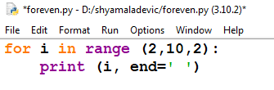
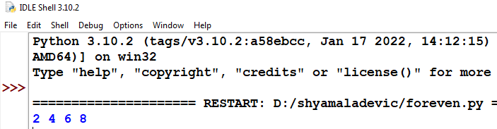
Example - Program to illustrate the use of for loop - to print single digit even number

Slide 53
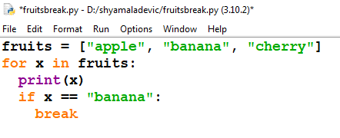
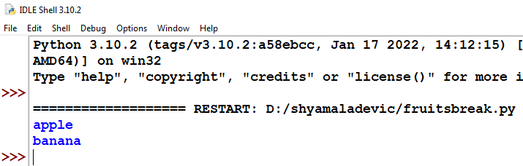
Example

Slide 54
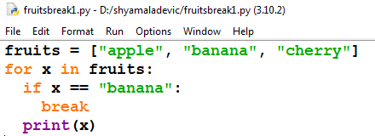
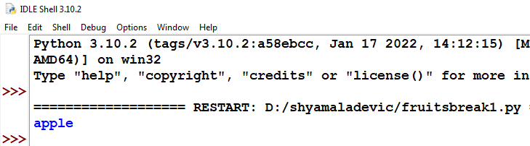
Example

Slide 55
for i in range (2,10,2):
print (i, end=‘ ‘)
fruits = ["apple", "banana", "cherry"]
for x in fruits:
print(x)
if x == "banana":
break

Slide 56
fruits = ["apple", "banana", "cherry"]
for x in fruits:
if x == "banana":
break
print(x)

Slide 57
The range() function returns a sequence of numbers, starting from 0 by default, and increments by 1 (by default), and ends at a specified number.

Slide 58
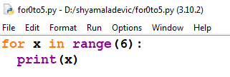
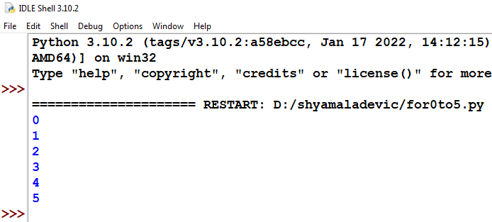
Example

Slide 59
for x in range(6):
print(x)

Slide 60
The range() function defaults to 0 as a starting value, however it is possible to specify the starting value by adding a parameter: range(2, 6), which means values from 2 to 6 (but not including 6):

Slide 61
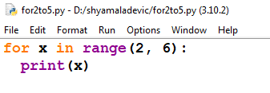
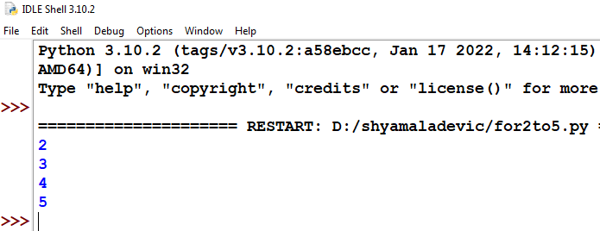
Example

Slide 62
for x in range(2, 6):
print(x)

Slide 63
The range() function defaults to increment the sequence by 1, however it is possible to specify the increment value by adding a third parameter: range(2, 30, 3):

Slide 64
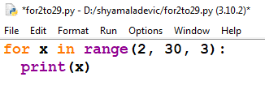
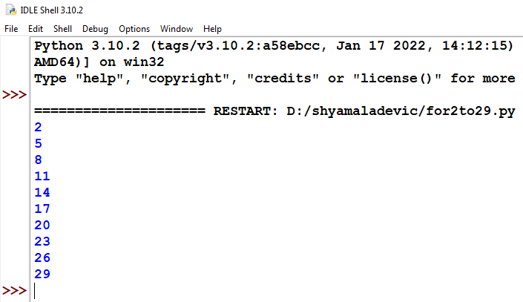
Example

Slide 65
for x in range(2, 30, 3):
print(x)

Slide 66
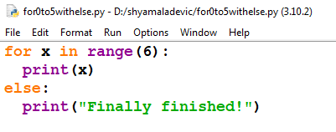
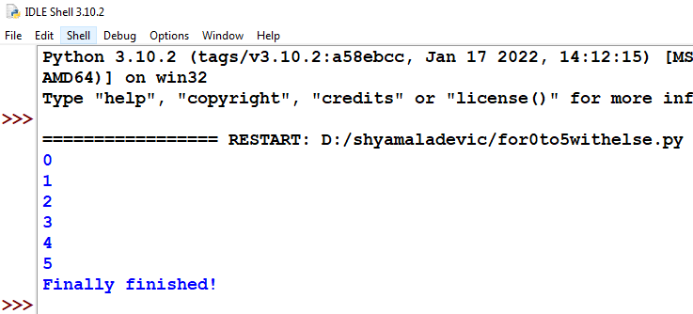
Example

Slide 67
for x in range(6):
print(x)
else:
print("Finally finished!")

Slide 68
Example
for i in range (2,10,2):
print (i, end=‘ ‘)
for i in range(2,10,2):
print (i,end=‘ ‘)
else:
print ("\nEnd of the loop")
n = 100
sum = 0
for counter in range(1,n+1):
sum = sum + counter
print("Sum of 1 until %d: %d" % (n,sum))

Slide 69
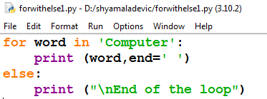
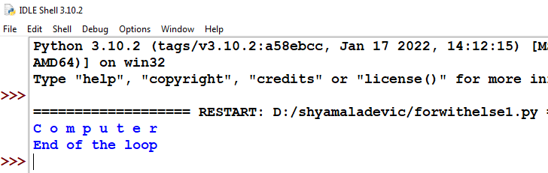
Example

Slide 70
for word in 'Computer':
print (word,end=' ')
else:
print ("\nEnd of the loop")

Slide 71
Nested loop
structure

Slide 72
A loop placed within another loop is called as nested loop structure.
One can place
a while within another while;
for within another for;
for within while and
while within for to construct such nested loops.

Slide 73
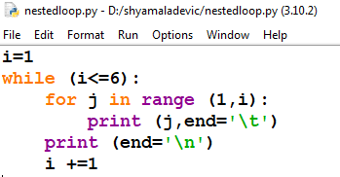
Example

Slide 74
i=1
while (i<=6):
for j in range (1,i):
print (j,end='\t')
print (end='\n')
i +=1

Slide 75
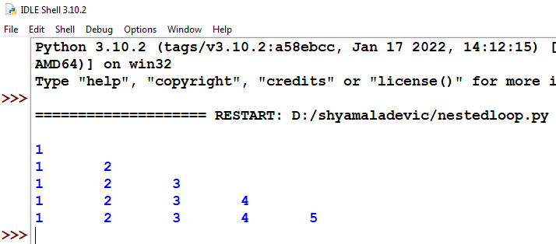

Slide 76
Jump Statements
in Python

Slide 77
The jump statement in Python, is used to unconditionally transfer the control from one part of the program to another.
There are three keywords to achieve jump statements in Python:
break, continue, pass.

Slide 78
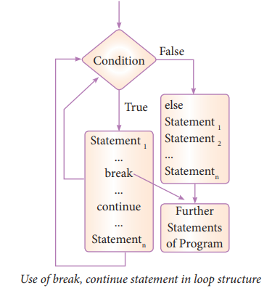

Slide 79
break statement

Slide 80
The break statement terminates the loop containing it.
Control of the program flows to the statement immediately after the body of the loop.

Slide 81
Syntax
break

Slide 82
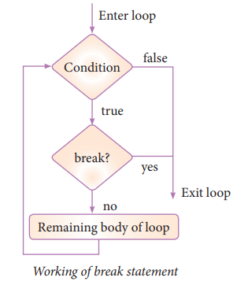

Slide 83
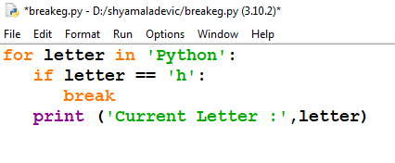
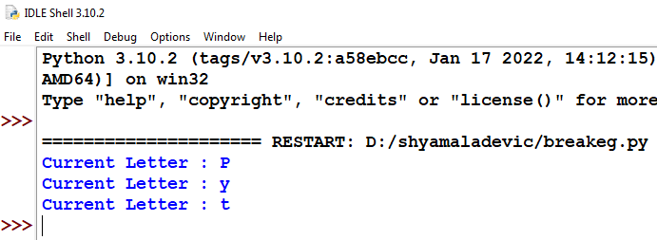
Example - Program to illustrate the use of break statement inside for loop.

Slide 84
for letter in ‘Python’:
if letter == 'h':
break
print ('Current Letter :',letter)

Slide 85
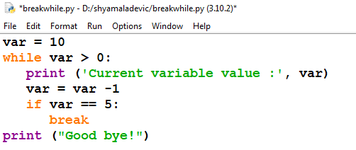
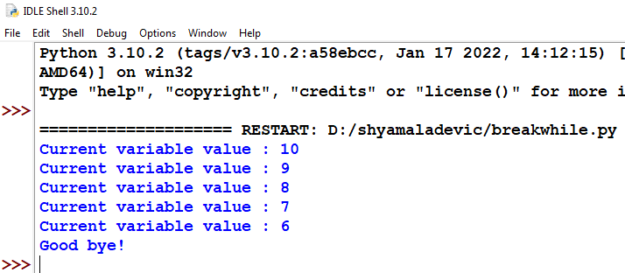
Example

Slide 86
var = 10
while var > 0:
print ('Current variable value :', var)
var = var -1
if var == 5:
break
print ("Good bye!")

Slide 87
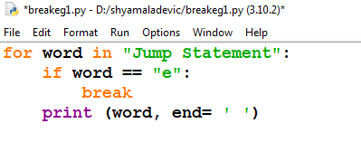
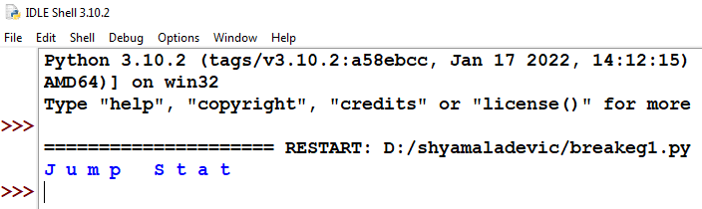
Example

Slide 88
for word in "Jump Statement":
if word == "e":
break
print (word, end= ‘ ‘)

Slide 89
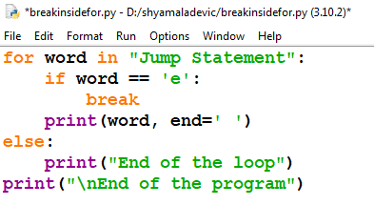
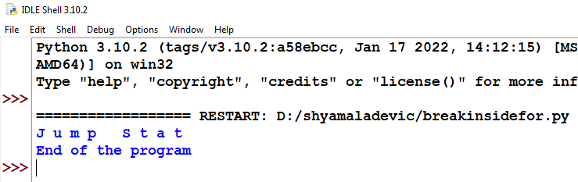
Example

Slide 90
for word in "Jump Statement":
if word == "e":
break
print (word, end='')
else:
print("End of the loop")
print("\n End of the program")

Slide 91
Continue
Statement

Slide 92
Continue statement unlike the break statement is used to skip the remaining part of a loop and start with next iteration.

Slide 93
Syntax
contiune

Slide 94
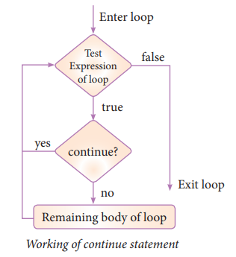

Slide 95
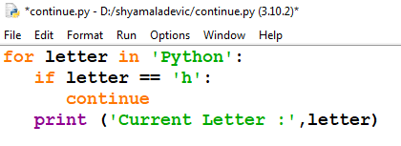

Example - Program to illustrate the use of continue statement inside for loop

Slide 96
for letter in 'Python’:
if letter == 'h':
continue
print ('Current Letter :',letter)

Slide 97


Example

Slide 98
var = 10
while var > 0:
var = var -1
if var == 5:
continue
print ('Current variable value :', var)
print ("Good bye!")

Slide 99



Slide 100
for word in "Jump Statement":
if word == "e":
continue
print (word, end='')
else:
print(“\n End of the loop”)
print(“\n End of the program”)

Slide 101
pass statement

Slide 102
Syntax
pass

Slide 103
pass statement in Python programming is a null statement.
pass statement when executed by the interpreter it is completely ignored. Nothing happens when pass is executed, it results in no operation.

Slide 104


Example - Program to illustrate the use of pass statement

Slide 105
for letter in 'Python':
if letter == 'h':
pass
print ('This is pass block')
print ('Current Letter :', letter)
print ("Good bye!")

Slide 106


Example

Slide 107
a=int (input("Enter any number :"))
if (a==0):
pass
else:
print ("non zero value is accepted")

Slide 108
Hands on Experience

Slide 109
Write a program to display
A
A B
A B C
A B C D
A B C D E

Slide 110


Slide 111

2. Using if..else..elif statement write a suitable program to display largest of 3 numbers.

Slide 112


Slide 113


3. Write a program to display all 2 digit odd numbers.

Slide 114

4. Write a program to display multiplication table for a given number.

Slide 115


Slide 116

5. Write a program to check if a number is Positive, Negative or zero.

Slide 117


Slide 118
Thank you

